Slide 1
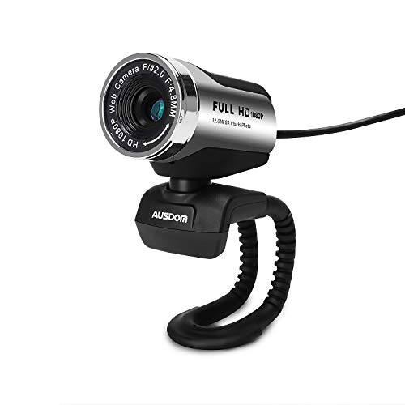
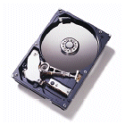
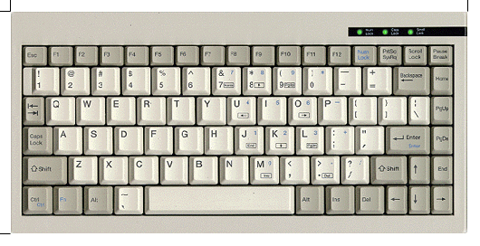
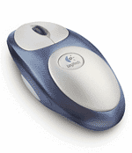
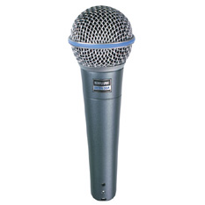

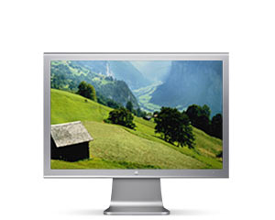
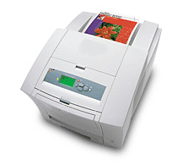
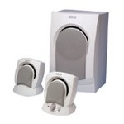
Typical I/O (Input/ Output) devices
Some input devices:
Keyboard
Mouse
Microphone
Camera
Mass storage
Network
Some output devices:
Printer
Speakers
Mass storage
Network
Display
Goal: write programs that create and process text, graphics, animation, and sound
How: using various language extensions, implemented by libraries.

Slide 2
The big picture
part of the host OS
device driver
supplied by Java
Java I/O library
friendly abstraction
StdDraw class
your Java program

Slide 3


The big picture
part of the host OS
device driver
device driver
supplied by Java
Java I/O library
Java I/O library
friendly abstraction
StdDraw class
In class
your Java program
StdAudio class
In class
files
Java I/O library
Java I/O library
Same basic software hierarchy for many I/O devices
device driver
device driver
files

Slide 4
The big picture
part of the host OS
device driver
device driver
supplied by Java
Java I/O library
Java I/O library
StdDraw class
In class
The programmer’s view of I/O:
Interacting with these classes
your Java program
StdAudio class
In class
Java I/O library
Java I/O library
Same basic software hierarchy for many I/O devices
device driver
device driver
files

Slide 5
The big picture
StdDraw class
In class
your Java program
StdAudio class
StdOut class

Slide 6
The big picture
StdDraw class
In class
your Java program
StdAudio class
StdOut class

